Slide 1

Fractional Frequency Transmission
Reporting group: 陈甘 程祎祥 满雨桐 姜照阳

Slide 2
CONTENT
01
02
032
Introduction and basic information
Fractional Frequency technique
Actual experiment

Slide 3
01
Introduction

Slide 4
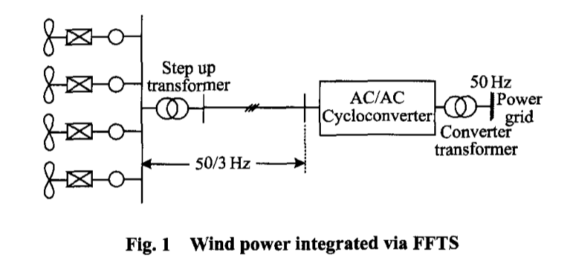

Introduction and basic information
The fractional frequency transmission system(FFTS) was proposed in 1994 as a novel electricity transmission approach, which uses lower frequency(50/3 Hz)to reduce the electrical length of AC power lines and thus obviously increases transmission capacity and efficiency．
The system is especially suitable to transmit remote renewable power such as hydro power and wind power．

Slide 5
Introduction and basic information
Aim
Principle
Improve the efficiency of electric energy transmission in route without increasing voltage level. It is especially suit for the transmission of hydro power and wind power, whose speed of the prime mover is relatively low.
Its main application now is largely in the transmission from the renewable energy power plant to the main grid.
Its basic principle comes from the reactance formula, as the reactance of the feeder is propotional to the frequency.
So with lower frequency(50/3 Hz, for example) we can reduce the reactance and thus reduce the loss in the transmission process.The more energe we send to the other end ,the higher the transmission effciency is.This is the single theory how Fractional Frequency Transmission works.

Slide 6
Introduction and basic information
Adventage
Flaws
The superiority of fractional frequency transmission is mainly reflected in lowering electrical frequency to reduce the reactance of transmission line, and thereby improving transmission efficiency and capacity.
This method comes up with a new perspective of improving the efficiency in transmission instead of the old way of increasing the voltage level.It has great potential to be explored and optimized.
As the saying goes, ‘No free lunch’. Its flaws come naturally from its advantage. Fractional Frequency Transmission uses a lower frequency, and that is the problem it has.
Different frequency requires new trasmission equipments that suit the frequency, because the normal grid uses 50Hz,which can not directly be applied to lower frequency.
What’s more, the method also requires high capacity electronic frequency convertor which is elaborate to produce and expensive.

Slide 7
02
Fractional Frequency

Slide 8
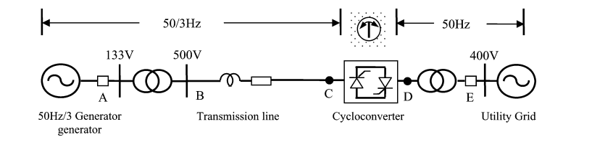
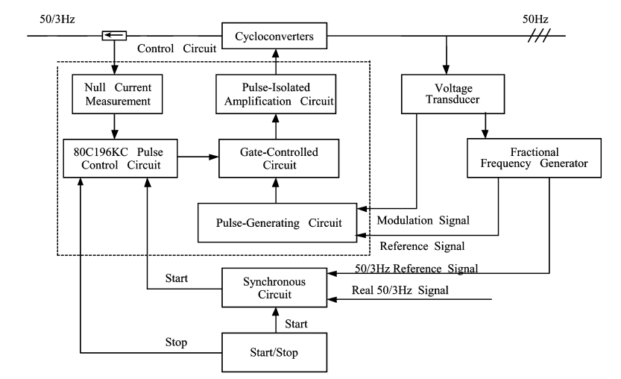
Basic Control Strategy
Fractional Frequency Generator
Synchronous Circuit
cycloconverter control circuit
Control system of cycloconverter(AC-AC frequency conversion)

Slide 9
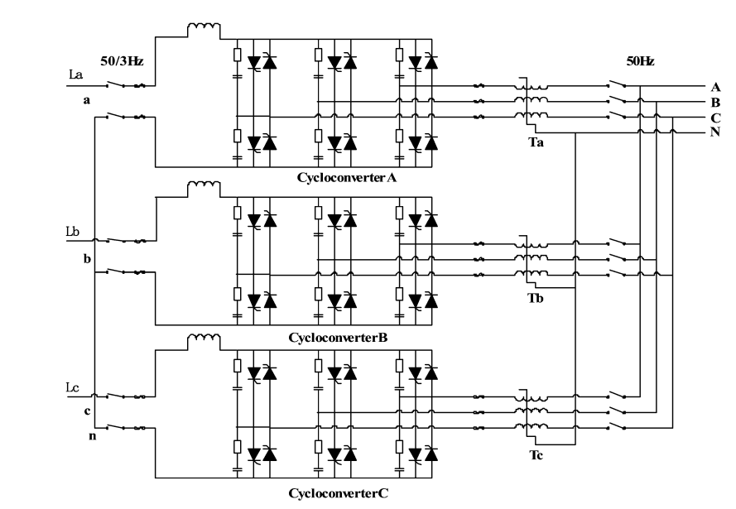
Types and Characteristics of Cycloconverter
1. Power electronic Cycloconverter: Take Three-phase 12-pulse inverter as an example. Thyristor devices are commonly used in this device. The device are composed of three-phase bridge-type fully-controlled rectifier circuits with positive and negative groups connected in anti-parallel. With the development of fully-controlled power electronics, thyristor phase-controlled inverters are no longer suitable for large-scale wind power access scenarios due to high harmonic content and uncontrollable power factor.
Cycloconverter Control Circuit

Slide 10
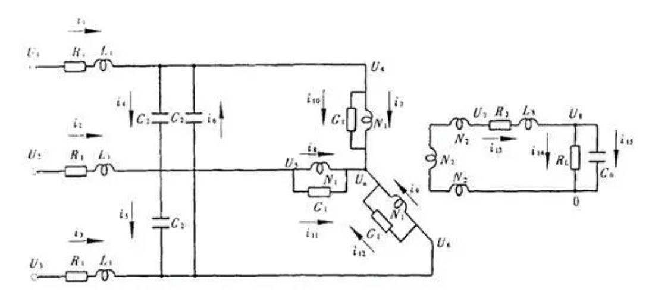
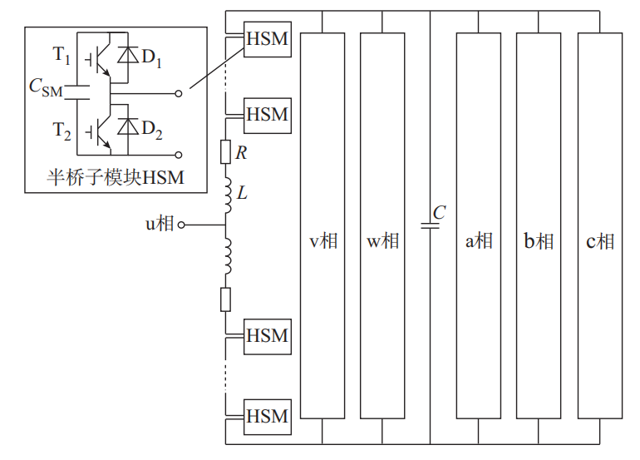
Types and Characteristics of Cycloconverter
3.Fully controlled power electronic converter: It has the advantages of flexibility and high efficiency, but the application scenarios are limited and the control strategies are complex.
2. Ferromagnetic Triple Frequency converter: The transformer operates in a highly saturated state, the nonlinearity of the magnetization curve of the iron core leads to the high third harmonic flux contained in the iron core, which generates the third harmonic induced voltage. It is widely used because its low cost and high reliability but the disadvantage is the low efficiency.
BTB-MMC AC/AC converter

Slide 11
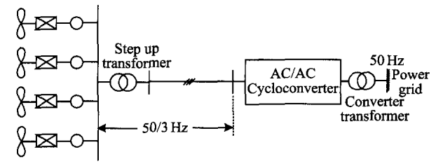
Fractional Frequency to Generator
reducing the number of pole pairs
The number of pole pairs of a low-speed permanent magnet generator (PMG) is usually more than 30 pairs, which will cause the large size of the rotor and stator.If combined with fractional frequency transmission system to send out 50/3 Hz power, the number of pole pairs will be greatly reduced, thus reducing its volume and weight . Therefore, in the offshore wind power generation system, the use of permanent magnet excitation and fractional frequency technique greatly simplifies the structure of the generator and reduces the maintenance of offshore wind turbines.

Slide 12

Fractional Frequency to other Devices ———
Transformer、Electrical Cable and Breaker
Transformer: Compared to a 50/60 Hz transformer with the same voltage level and core material, transformers operated in the low frequency AC grid, including wind turbine transformers, step-up transformers and converter transformers, have larger volume and weight due to the increased N and S.
Electrical Cable: Under low operating frequency conditions, the reactance of the transmission line is significantly reduced, thereby reducing the voltage drop along the line path. At the same time The dependence of the voltage on the real and reactive power flows is significantly reduced. The sensitivity of the voltage to reactive power variations can be reduced in the LFAC system, which means more stable voltage supply and higher stability margins than in the conventional 60 Hz system.
Breaker: Applied to low-frequency scenarios, the breaker’s electromagnetic suction force decreases, thus delaying the movement of disconnection. As the result, the electric arc energy of the short-circuit current will increase, affecting the performance of the circuit breaker itself. So the design of the circuit breaker needs to be optimized for application on low-frequency circumstance.
B=$\frac{U}{\sqrt{2}πfNS}$
f decreases,B increases saturation
need the increasement of N and S.

Slide 13
03
Actual Experiment

Slide 14
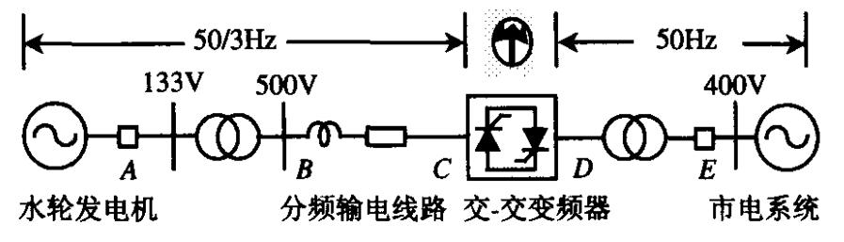

50/3 Hz
50 Hz
Hydroelectric Generator
Transformer
Frequency Multiplier
~
Transmission Line

Slide 15
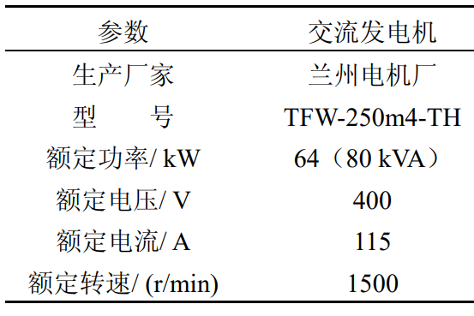
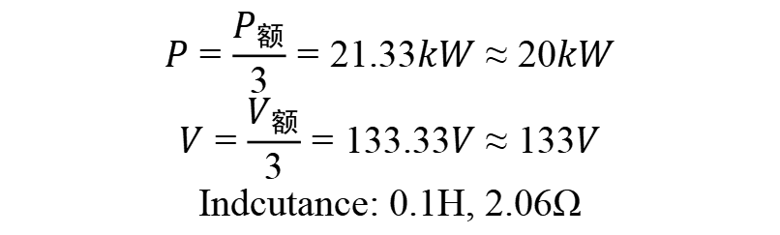
$$P=\frac{P_{额}}{3}=21.33kW≈20kW$$
$$V=\frac{V_{额}}{3}=133.33V≈133V$$
Indcutance: 0.1H, 2.06Ω

Slide 16
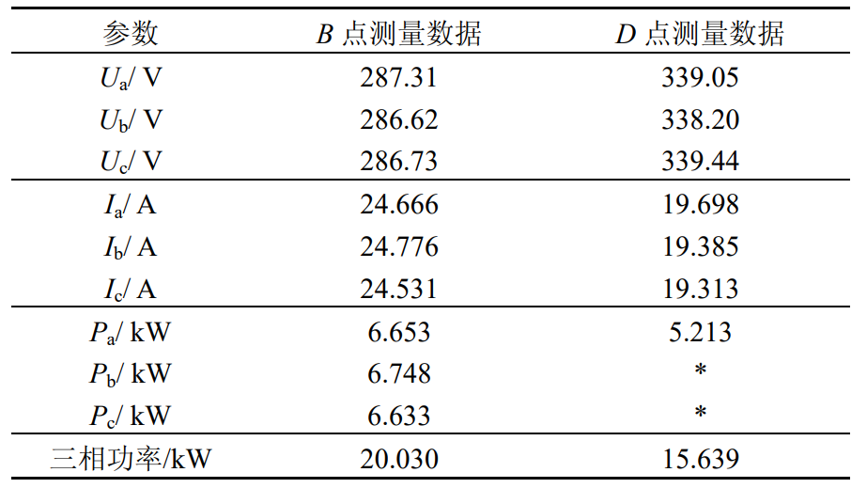
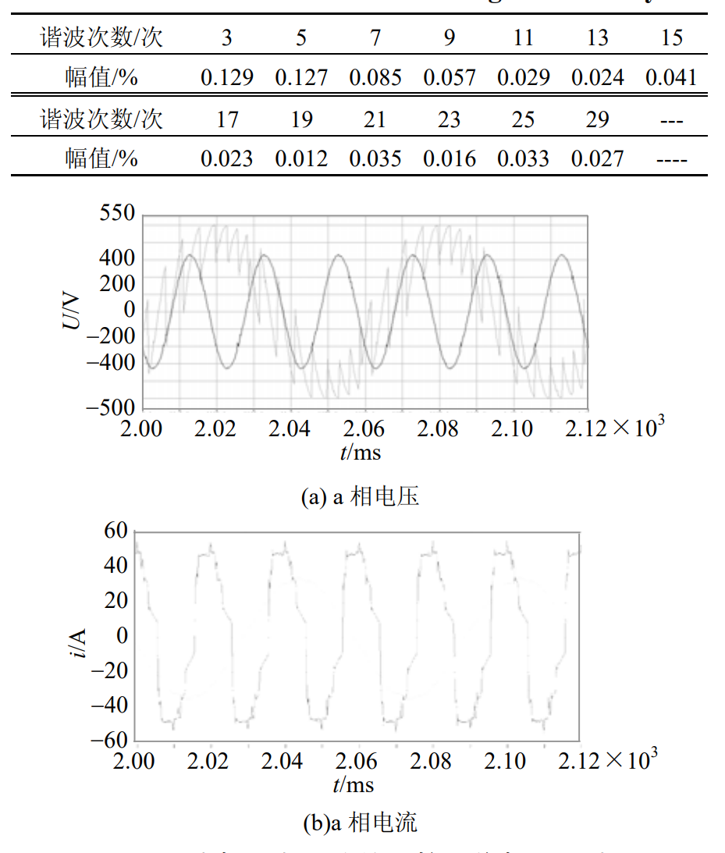
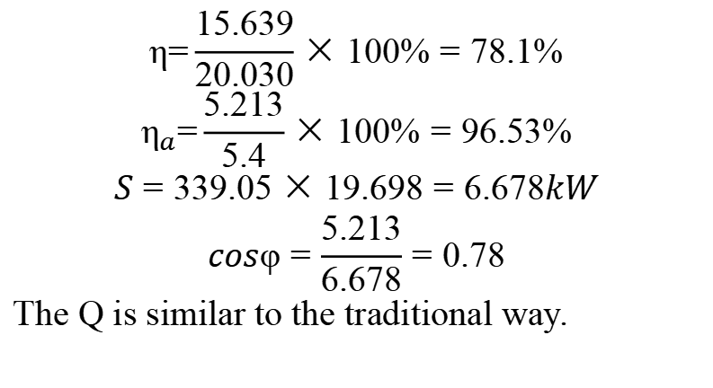
$$\text{η}\text{=}\frac{15.639}{20.030}×100\%=78.1\%$$
$${\text{η}}_{a}\text{=}\frac{5.213}{5.4}×100\%=96.53\%$$
$$S=339.05×19.698=6.678kW$$
$$cosφ=\frac{5.213}{6.678}=0.78$$
The Q is similar to the traditional way.

Slide 17

Does it really have an advantage compared with the traditional way?
Consider 500V→500kV
0.1H→1H
2.06Ω →20.6Ω
20kW →2000MW
$$ωL=314.16×1=314.16Ω$$
$$P_{max}=\frac{{500}^{2}}{314.16}=759.77MW$$
$$n=\frac{2000}{759.77}≈2.5$$
Advantages:
Higer Efficiency
Suit for new energy power generation
Disadvantages:
Transformer

Slide 18
THANKS！
TSINGHUA UNIVERSITY

